Slide 1
Deep Q Network (DQN) Algorithm

Slide 2
INTRODUCTION
Origin of Deep Reinforcement Learning is pure Reinforcement Learning, where problems are typically framed as Markov Decision Processes (MDP).
The MDP consists of a set of states S and actions A. Transitions between states are performed with transition probability P, reward R and a discount factor gamma.
Probability transition P (system dynamics) reflects the number of different transitions and rewards occurrence from one state to the other, where the sequential state and reward depend only on the state and action taken at the previous time step.

Slide 3
INTRODUCTION
Reinforcement Learning defines environment for the Agent to perform certain actions (according to policy) to maximize the reward.
The foundation of optimal behavior of the Agent is defined by Bellman equation, which is a widely used method for solving practical optimization problems. To solve the Bellman optimal equation, we use a dynamic programming.
When the agent exists in environment and transits to the other state (position) we need to estimate the value of the state V(s) (position) — state value function.
Once we know the value of each state we can figure out what is the best way to act Q(S, A) — action value function (simply by following the state that with the highest value).

Slide 4

INTRODUCTION
These two mappings or functions are very much interrelated and help us find an optimal policy for our problem.
We can express that state value function tells us how good is it to be in state S if the Agent follows policy 𝜋.
Meaning of symbols is as follows:
E[X] — expectation of random variable X
𝜋 — policy
Gt — discounted return at time t
γ — discount rate

Slide 5
INTRODUCTION
However, the action-value function q (s, a) is the expected return starting from state S, taking action A, and following policy 𝜋 and tells us how good is it to take a particular action from a particular state,
It is smart to mention that the difference between the state value function and the Q function is that the value function specifies the goodness of a state, while a Q function specifies the goodness of an action in a state.

Slide 6

INTRODUCTION
The MDP is solved by Bellman equation, named after Richard Bellman, American mathematician. The equation contributes in finding the optimal policies and value functions.
The Agent chooses the action according to the imposed policy (strategy — formally, policy is defined as the probability distribution over actions for every possible state).
Different policies the Agent can follow implies different value functions for the state. However, if the goal is to maximize the collected rewards, we have to find the best possible policy, called optimal policy.

Slide 7


INTRODUCTION
On the other hand the optimal state value function is the one that has a higher value compared to all other value functions (maximum return), therefore the optimal value function can be also estimated by taking the maximum of the Q :
Finally, the Bellman equation for the value function can be represented as,

Slide 8



INTRODUCTION
Similarly, the Bellman equation for the Q function can be represented as follows:
Based on optimal state value function and above equations for state value function action-value function we can arrange final equation for optimal value function called Bellman optimal equation:

Slide 9
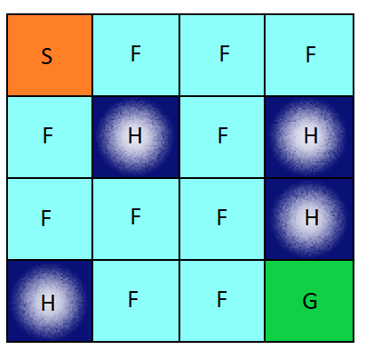
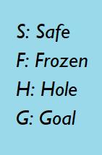
Q — learning
Generally, the Reinforcement Learning problems are solved using Q — learning algorithms. Here, as it was mentioned above the Agent interacts with the Environment and receives rewards.
The goal, is to elaborate the optimal policy (strategy for action choice) to maximizes the reward. During the learning process the Agent update Q(S,A) table (the termination is done when the episode is end — reached the goal).

Slide 10
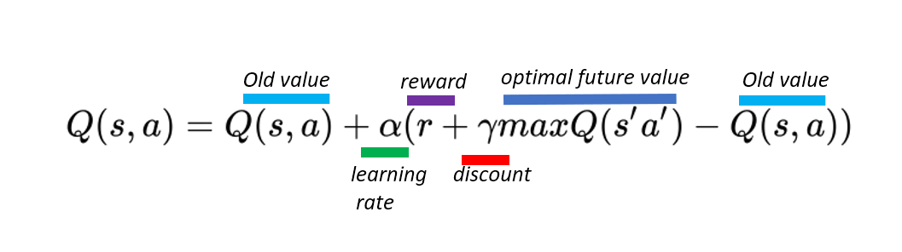
Q — learning algorithm
Q — learning algorithm is perform according to following steps:
1. Initialize Table Q(S,A) with random values.
2. Take a action (A) with epsilon — greedy policy and move to next state S’
3. Update the Q value of a previous state by following the update equation:

Slide 11
Q — learning algorithm
The best way to start is to solve the Frozen Lake environment from the OpenAI gym.
In Frozen Lake environment (please be familiar with OpenAI description) the Agent can stay in 16 States and perform 4 different actions (in one states). In this case our Q(S,A) table has a size 16 x 4.

Slide 12
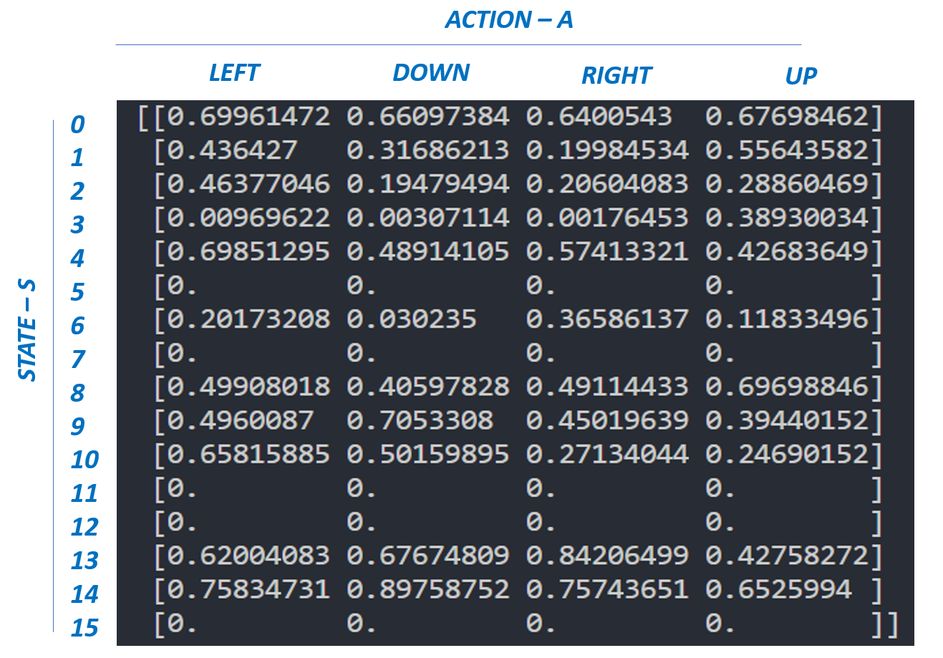

Slide 13

Temporal Difference Learning algorithms
the given above Q — algorithm belongs to Temporal Difference Learning algorithms (by Richard S. Sutton in 1988 ). Q — algorithm is a off — policy algorithm (as the ability of the method to learn on old historical data). Extension of Q — learning algorithm is a SARSA (on — policy algorithm. The only difference is the Q(S,A) table update:

Slide 14
DEEP Q — NETWORKS — DQN
Reinforcement learning can be sufficiently applicable to the environment where the all achievable states can be manged (iterated) and stored in standard computer RAM memory.
However, the environment where the number of states overwhelms the capacity of contemporary computers (for Atari games there are 12833600 states) the standard Reinforcement Learning approach is not very applicable.
Furthermore, in real environment, the Agent has to face with continuous states (not discrete), continuous variables and continuous control (action) problems.

Slide 15
DEEP Q — NETWORKS — DQN
Bearing in mind the complexity of environment the Agent has to operate in (number of states, continuous control) the standard well defined Reinforcement Learning Q — table is replaced by Deep Neural Network (Q — Network) which maps (non — linear approximation) environment states to Agent actions. Network architecture, choice of network hyper parameters and learning is performed during training phase (learning of Q — Network weight).
DQN allows the Agent to explore unstructured environment and acquire knowledge which over time makes them possible for imitating human behavior.

Slide 16
LEARNING ALGORITHM DQN
The main concept of DQN was depicted on below figure (during training process), where Q — network proceeds as a as nonlinear approximation which maps both state into an action value.
During the training process, the Agent, interacts with the environment and receives data, which is used during the learning the Q — network. The Agent explores the environment to build a complete picture of transitions and action outcomes. At the beginning the Agent decides about the actions randomly which over time becomes insufficient.
While exploring the environment the Agent tries to look on Q — network (approximation) in order to decide how to act. We called this approach (combination of random behavior and according to Q — network) as an epsilon — greedy method (Epsilon -greedy action selection block), which just means changing between random and Q policy using the probability hyper parameter epsilon.

Slide 17

LEARNING ALGORITHM DQN
The core of presented Q-learning algorithm is derived from the supervised learning.
Here as it was mention above, the goal is to approximate a complex, nonlinear function Q(S, A) with a deep neural network.
Similarly, to supervised learning, in DQN, we can define the loss function as the squared difference between the target and predicted value, and we will also try to minimize the loss by updating the weights (assuming that the Agent performs a transition from one state s to the next state s’ by performing some action a and receive a reward r).

Slide 18
LEARNING ALGORITHM DQN
During the learning process we use two separate Q — networks (Q_network_local and Q_network_target) to calculate the predicted value (weights θ) and target value (weights θ’).
The target network is frozen for several time steps and then the target network weights are updated by copying the weights from the actual Q network.
Freezing the target Q — network for a while and then updating its weights with the actual Q network weights stabilizes the training.

Slide 19
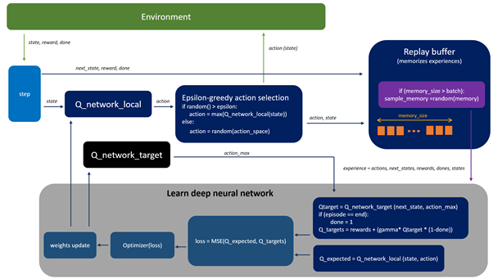

Slide 20
LEARNING ALGORITHM DQN
In order to make training process more stable (we would like to avoid learning network on data which is relatively correlated, which can happen if we perform learning on consecutive updates — last transition)
we apply replay buffer which memorizes experiences of the Agent behavior. Then, training is performed on random samples from the replay buffer ( this reduces the correlation between the agent’s experience and helps the agent to learn better from a wide range of experiences).

Slide 21
DQN algorithm
The DQN algorithm can be describes as follows:
1. Initialize replay buffer,
2. Pre-process and the environment and feed state S) to DQN, which will return the Q values of all possible actions in the state.
3. Select an action using the epsilon-greedy policy: with the probability epsilon, we select a random action A and with probability 1-epsilon. Select an action that has a maximum Q value, such as A = argmax(Q(S, A, θ)).
4. After selecting the action A, the Agent performs chosen action in a state S and move to a new state S’ and receive a reward R.

Slide 22
DQN algorithm
5. Store transition in replay buffer as <S,A,R,S’>.
6. Next, sample some random batches of transitions from the replay buffer and calculate the loss using the formula:
7. Perform gradient descent with respect to actual network parameters in order to minimize this loss.
8. After every k steps, copy our actual network weights to the target network weights.
9. Repeat these steps for M number of episodes.

Slide 23
PROJECT SETUP. RESULTS.
results of the project implementation by Udacity (Deep Reinforcement Learning)
a. GOAL in the project
In this project, the goal was to train the Agent to navigate in square environment how to collect yellow bananas. Project requirement is to collect average score of +13 over 100 consecutive episodes.

Slide 24
PROJECT SETUP. RESULTS
b. In Navigation project following setup of neural network architecture and hyper parameters were applied:
Depicted below plot of rewards per episode illustrates that the Agent is able to receive an average reward (over 100 episodes) of at least +13 while playing 2247 episodes.
Q-Network architecture:
Input layer FC1: 37 nodes in, 64 nodes out
Hidden layer FC2: 64 nodes in, 64 nodes out
Hidden layer FC3: 64 nodes in, 64 nodes out
Output layer: 64 nodes in, 4 out — action size

Slide 25
PROJECT SETUP. RESULTS
Applied hyper parameters:
BUFFER_SIZE = int(1e5) # replay buffer size
BATCH_SIZE = 64 # mini batch size
GAMMA = 0.99 # discount factor
TAU = 1e-3 # for soft update of target parameters
LR = 5e-4 # learning rate
UPDATE_EVERY = 4 # how often to update the network
Epsilon start = 1.0
Epsilon start = 0.01
Epsilon decay = 0.999

Slide 26
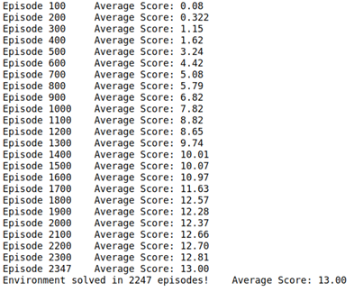
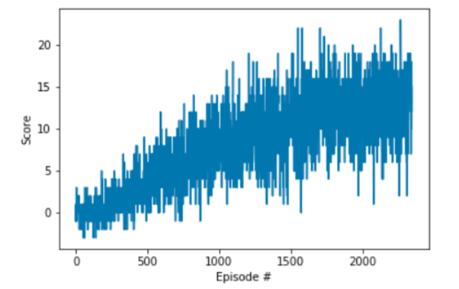

Slide 27
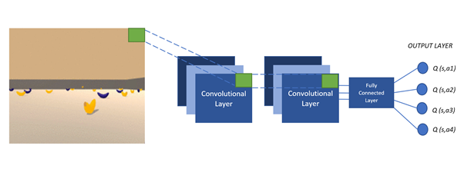
IDEAS OF FUTURE WORK
the future work will concentrate with applying image management (Learning from pixels). The architecture of DQN is shown in the following figure, where we feed a game screen and Q network approximates the Q value for all actions in that game state. Furthermore, the action is estimated as in discussed DQN algorithm.

Slide 28
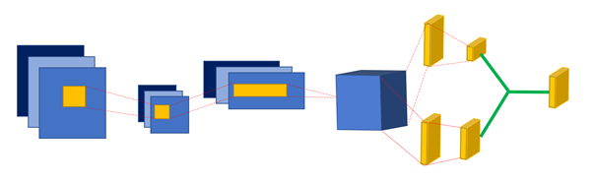
Architecture of dueling DQN
Secondly the future work will focus on implementing a Dueling of DQN. In this new architecture we specify new advantage function, which specifies how good it is for an agent to perform an action a compared to other actions (Advantage could be positive or negative).
The architecture of dueling DQN is the same as described above DQN, except that the fully connected layer at the end is divided into two streams

Slide 29
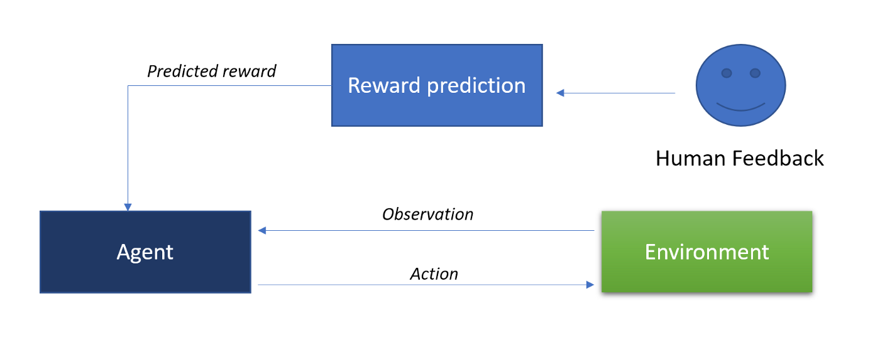

Slide 30
Architecture of dueling DQN
In environments with certain number of action space in a one state the most of the computed actions will not have any effect on the state. Additionally, there will be number of actions with redundant effects. In this case the new dueling DQN will estimate the Q values more precisely than the DQN architecture.
One stream computes the value function, and the other stream computes the advantage function (to decide which action is preferred over the other).
Lastly, we can consider to Learning from human preference (OpenAI and Deep Mind). The main idea of thin new concept is to learn the Agent according to human feedback. The agent, receiving the human feedback will try to do the actions preferred by the human and set the
reward accordingly. Human interaction with the Agent directly contributes to overcome the challenge connected with designing the reward function and complex goal functions.

Slide 31
Thank YOU

